Slide 1
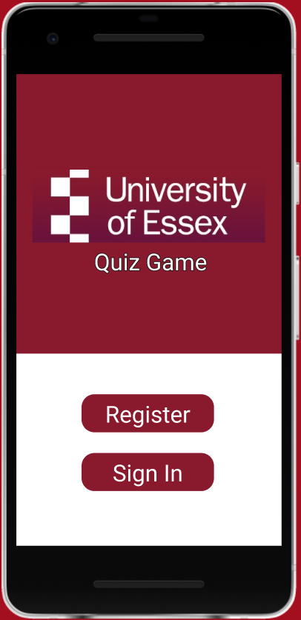
User lands on home page

Slide 2
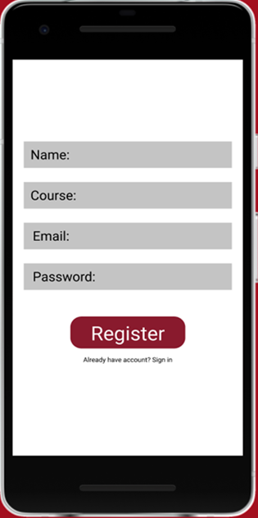
User registers with their name, course, email and password
If user already has an account, they should sign in

Slide 3
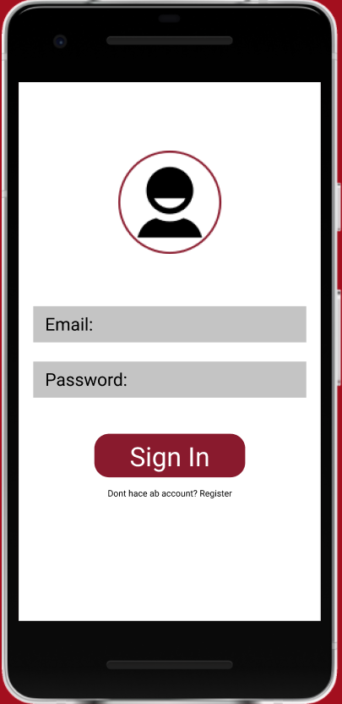
User need to sign in to start the quiz but if the user does not have an account then they should register

Slide 4
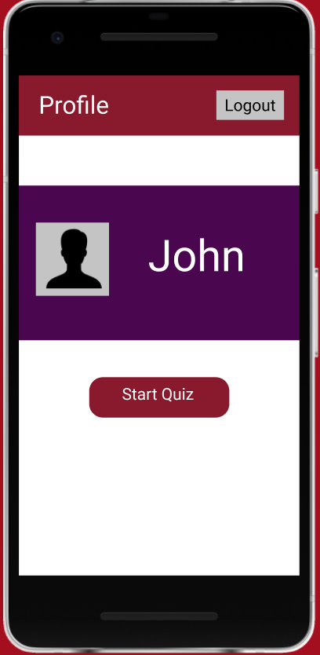
User can navigate to their profile to start the quiz and also to other profiles

Slide 5
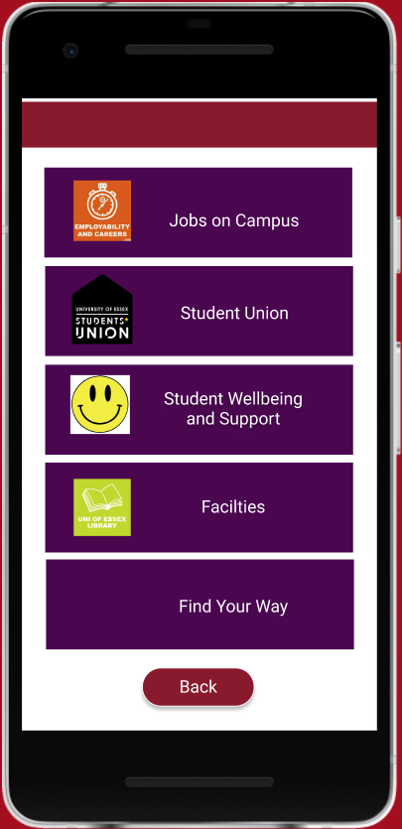
The user can see all the categories and choose one to take the quiz on

Slide 6
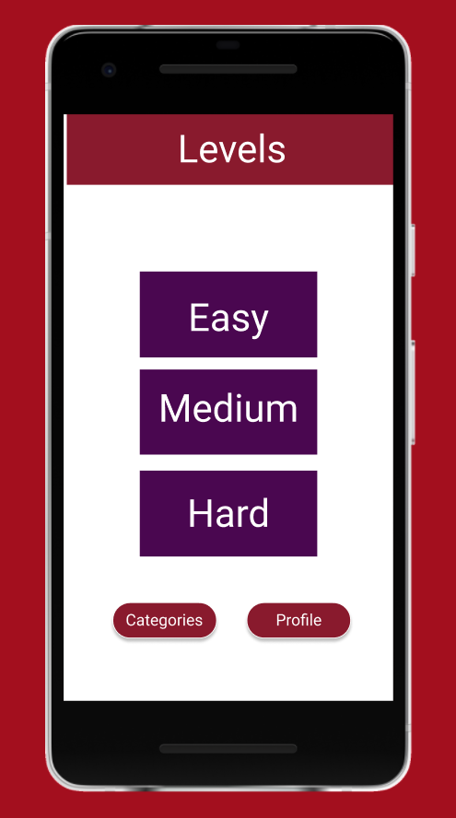
The user can choose the level of difficulty

Slide 7
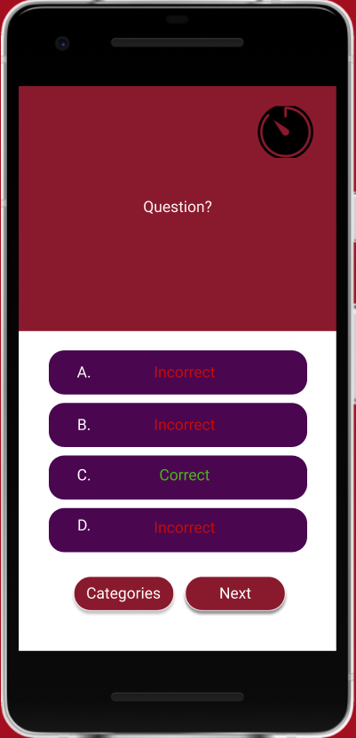
The user answers the questions, click ‘next’ to move onto next question The user can also go back to categories

Slide 8
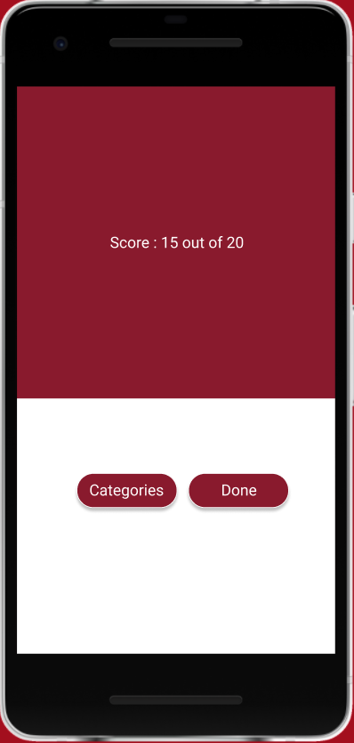
The user can see their total score at the end of the quiz They can go back to the categories or select done when finished

Slide 9
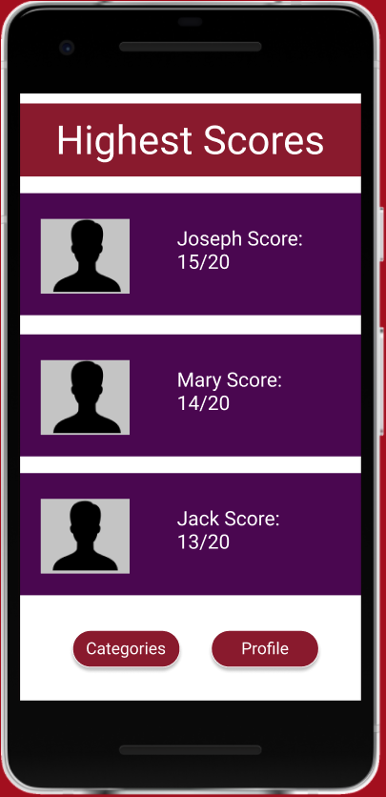
The user can see the highest scorer of the quiz challenge them and try beat them by getting a higher score than them The user can go back to categories or to their profile

Slide 10
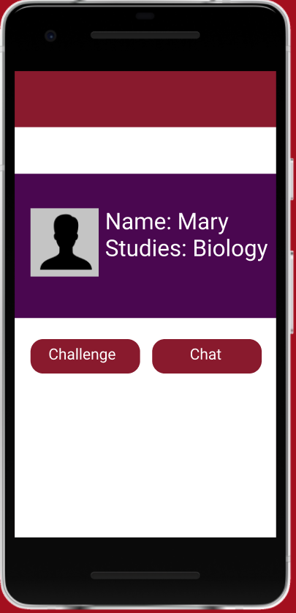
The user can see other user profiles and challenge them or chat to them

